Slide 1
A New Method and a Non-Invasive Device to Estimate Anemia Based on Digital Images of the Conjunctiva
Link to Paper

Slide 2
AIM
Why Conjunctiva?
Preprocessing
To develop a device that is not expensive and simple to use for assessing the anemic condition
Many studies show great interest in the pallor of body parts to estimate Anemia such as palmar pallor, image processing of a fingertip video, conjunctival pallor, etc.
One of the studies compared the analysis of palmar and conjunctival pallor to detect Anemia: they found that there was a greater level of sensitivity to conjunctival pallor than to palmar pallor
Also, for many years, physicians in common practice have estimated Anemia in people by observing the eyelid conjunctiva.
Thus observing the eyelid conjunctiva can provide information for suspecting Anemia
To create a gold standard dataset for the specific area of the conjunctiva to be examined, the palpebral conjunctiva of the acquired samples were manually segmented by a haematologist

Slide 3
Dataset
Threshold
Feature Selection
Cross Validation
The statistical analysis was performed on data from 113 participants (63 men, 50 women)
Threshold for the patient’s condition was estimated as
high-risk (Hb<10.5 g/dl),
doubtful (10.5 < Hb <11.5), and low-risk (Hb > 11.5),
in terms of the chance of having Anemia.
After many experiments, the best classification result were obtained by considering 3 features in total, namely, a*, b* and the G value extracted from the RGB component images.
A kNN classifier and a 10-fold cross-validation test were used to estimate the risk of Anemia by means of the digital images of the conjunctive that were acquired

Slide 4
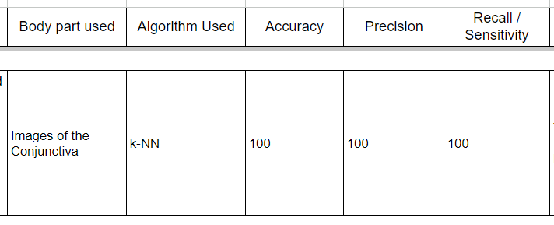
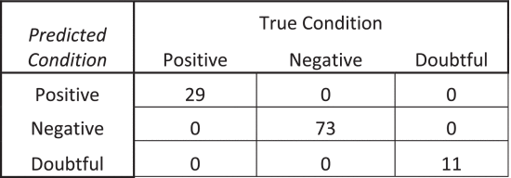
Performance Metrics
Confusion Matrix

